Slide 1
What is Hypergraph?
A visual web-based tool based on graphs, viewers, and relations
A tool that support Model Driven Development
A tool to generate tools and applications
A tool grounded over a Content Management System
A tool integrating multiple viewers/editors for multiple content types
A tool to organize content in a relational way
Meta-model
Domain Specific Language
Model
Code Generation
Tests
Application Execution
Application
Documentation
No-code

Slide 2
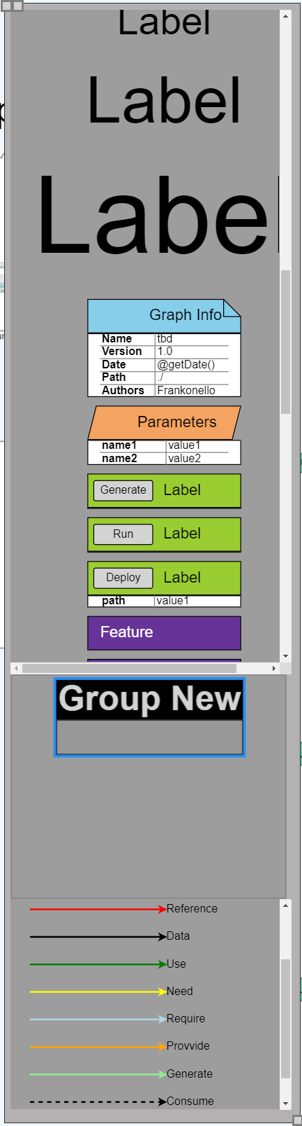
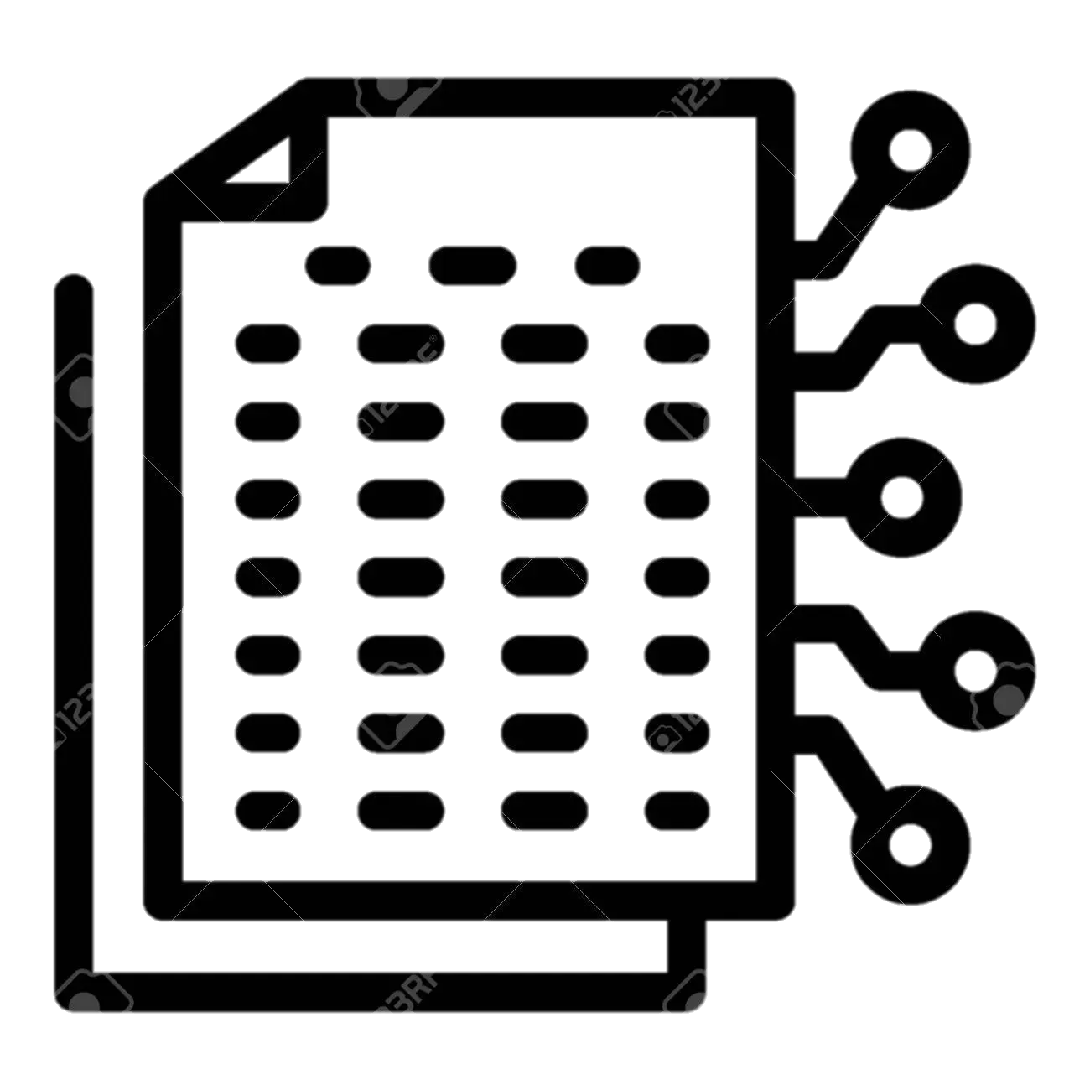
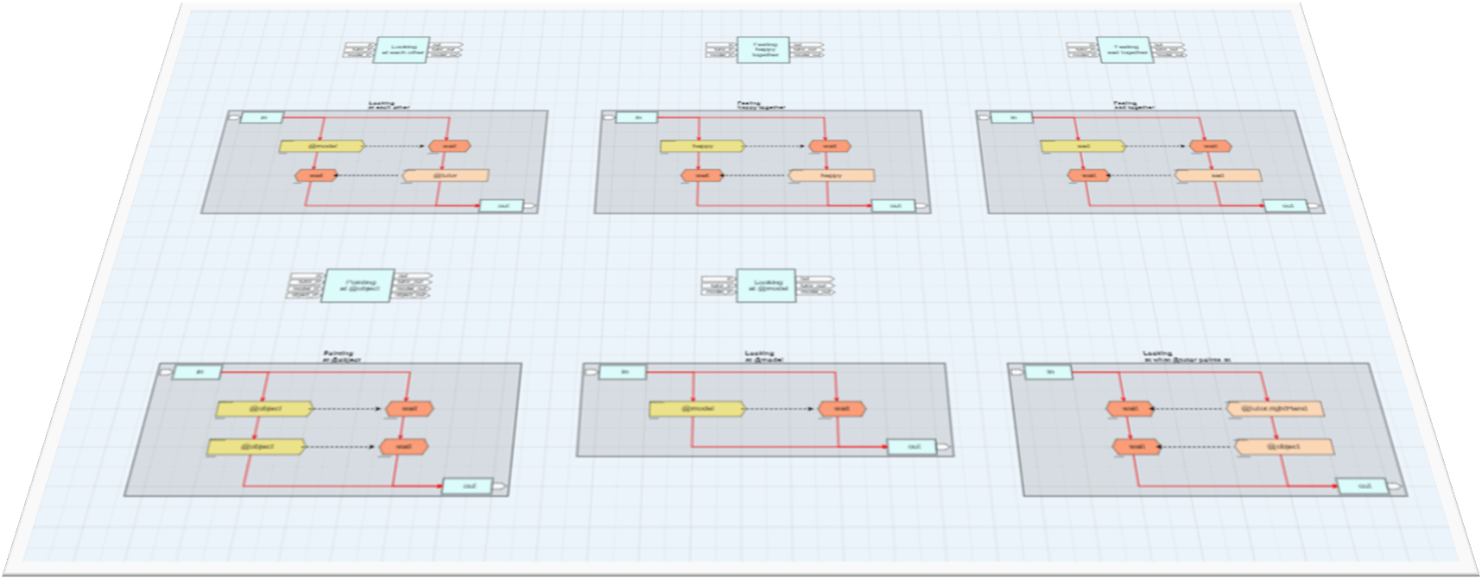
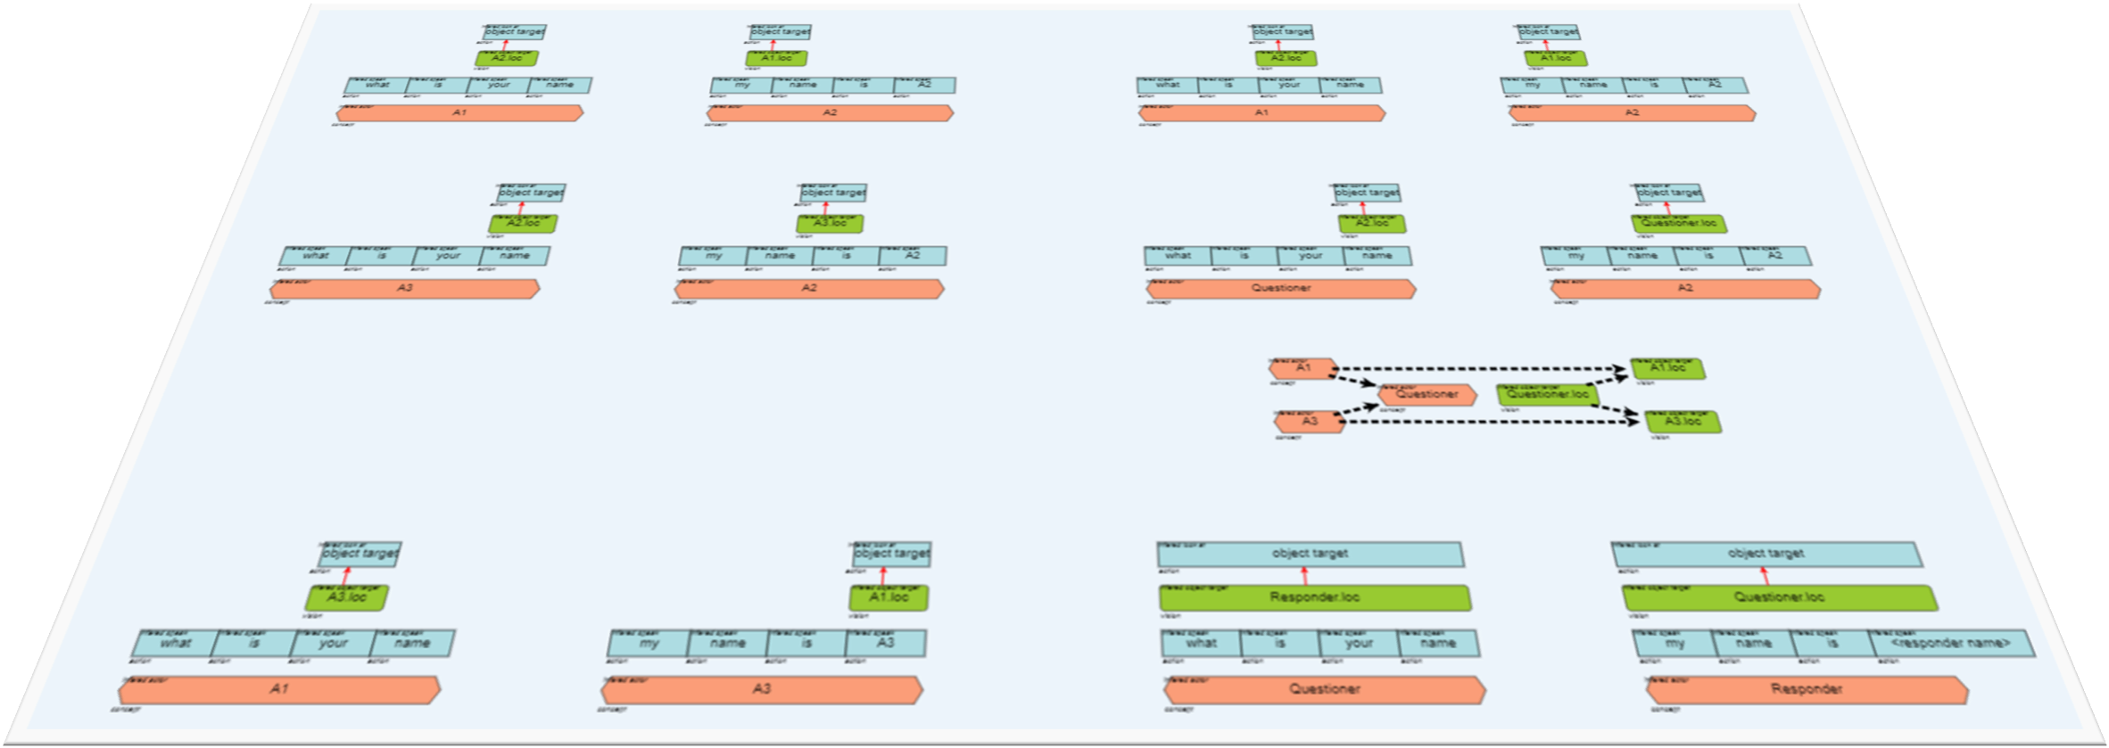
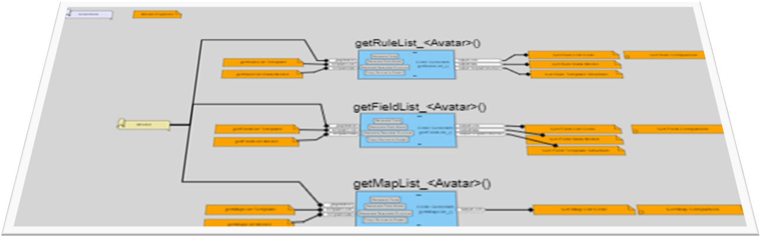
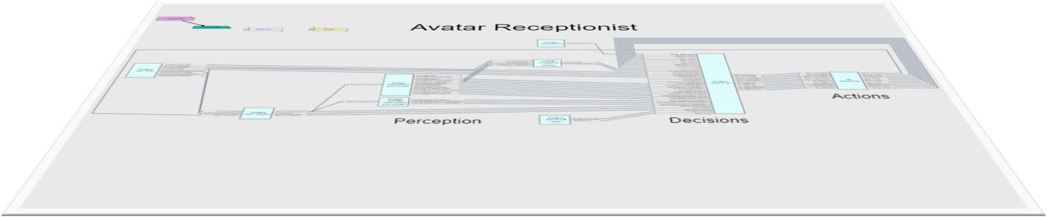
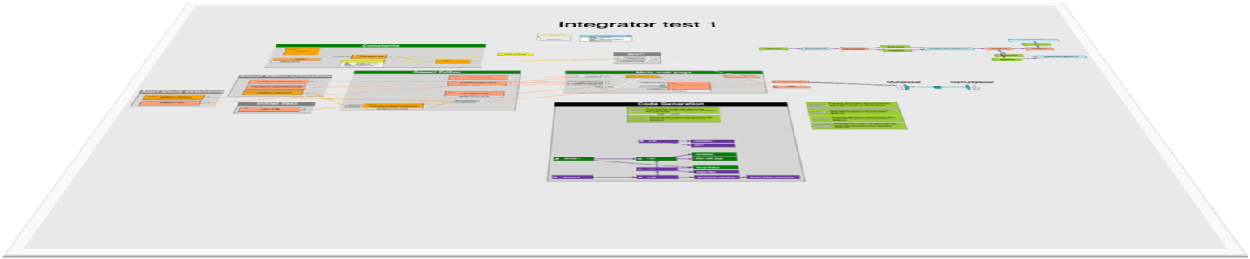
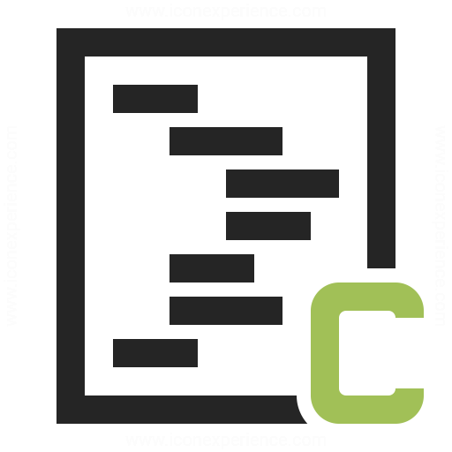
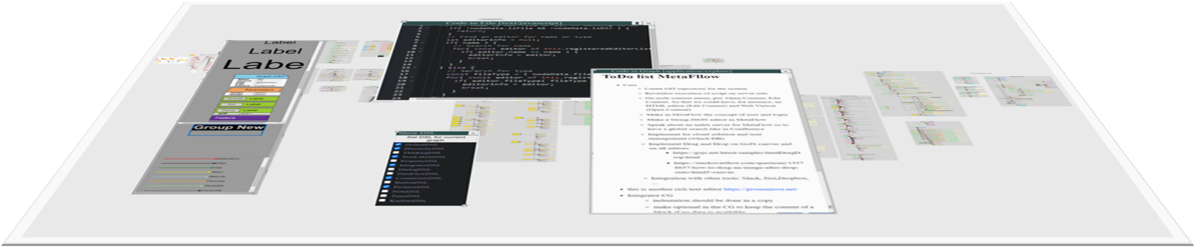
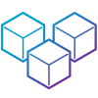
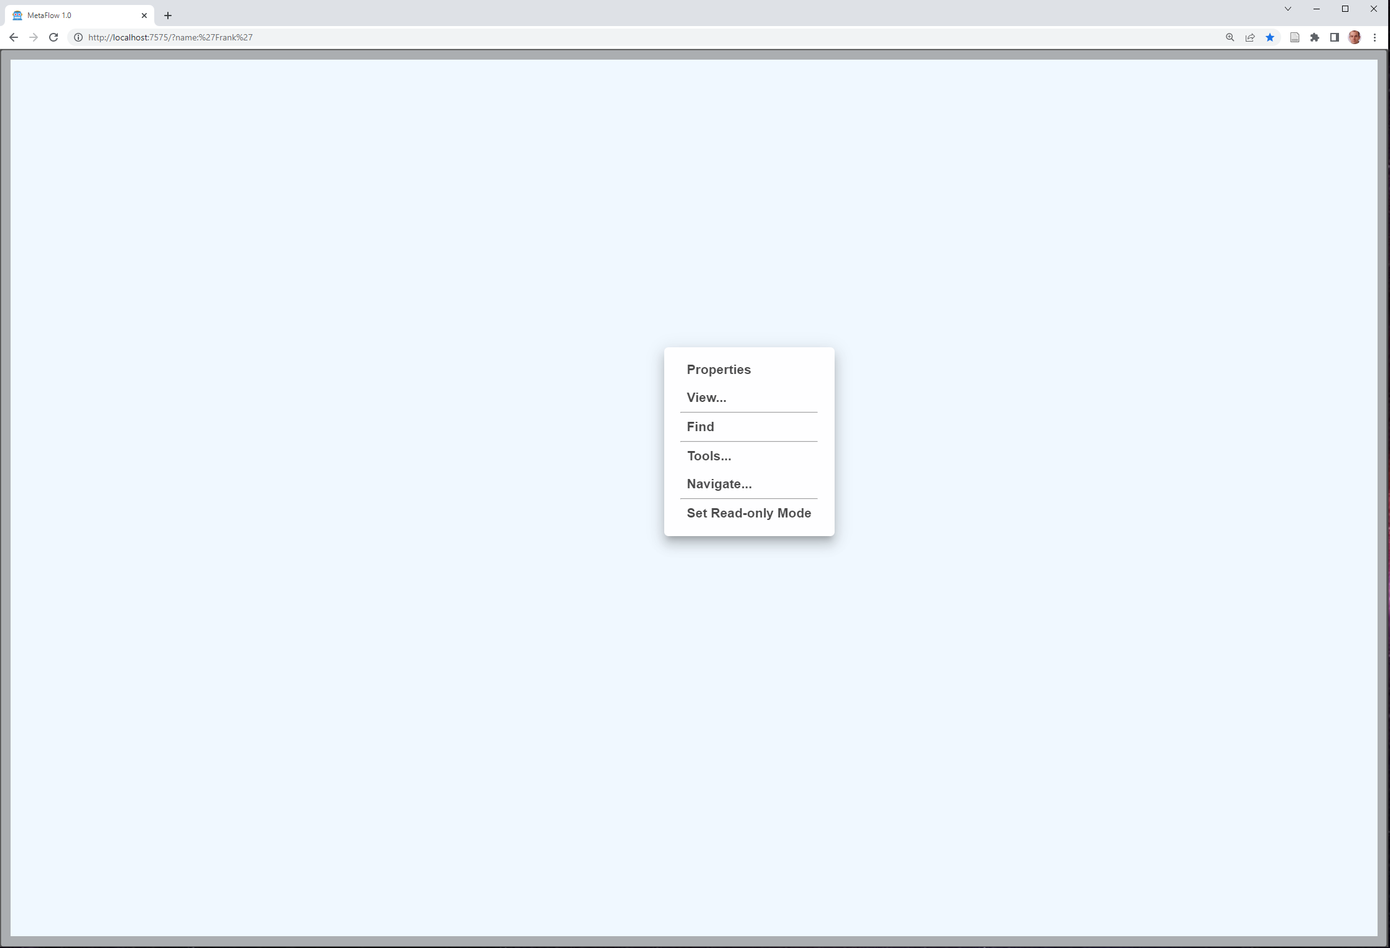
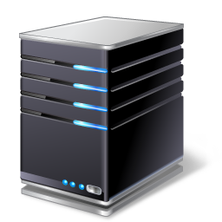





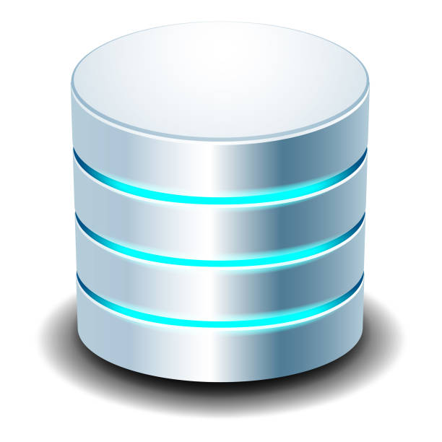
DSL
Navigation (Files, Gates) → OS
Brainstorming → Miro,…
DataFlow → ToolBOS, RTMaps,…
CodeFlow
DialogFlow → Avatar Receptionist
Workspace
Workspace
Data Model
Code Generation
Workspace
Workspace
Workspace
Workspace
Code
Doc
µServices
Program
Server
Browser
DB
App

Slide 3
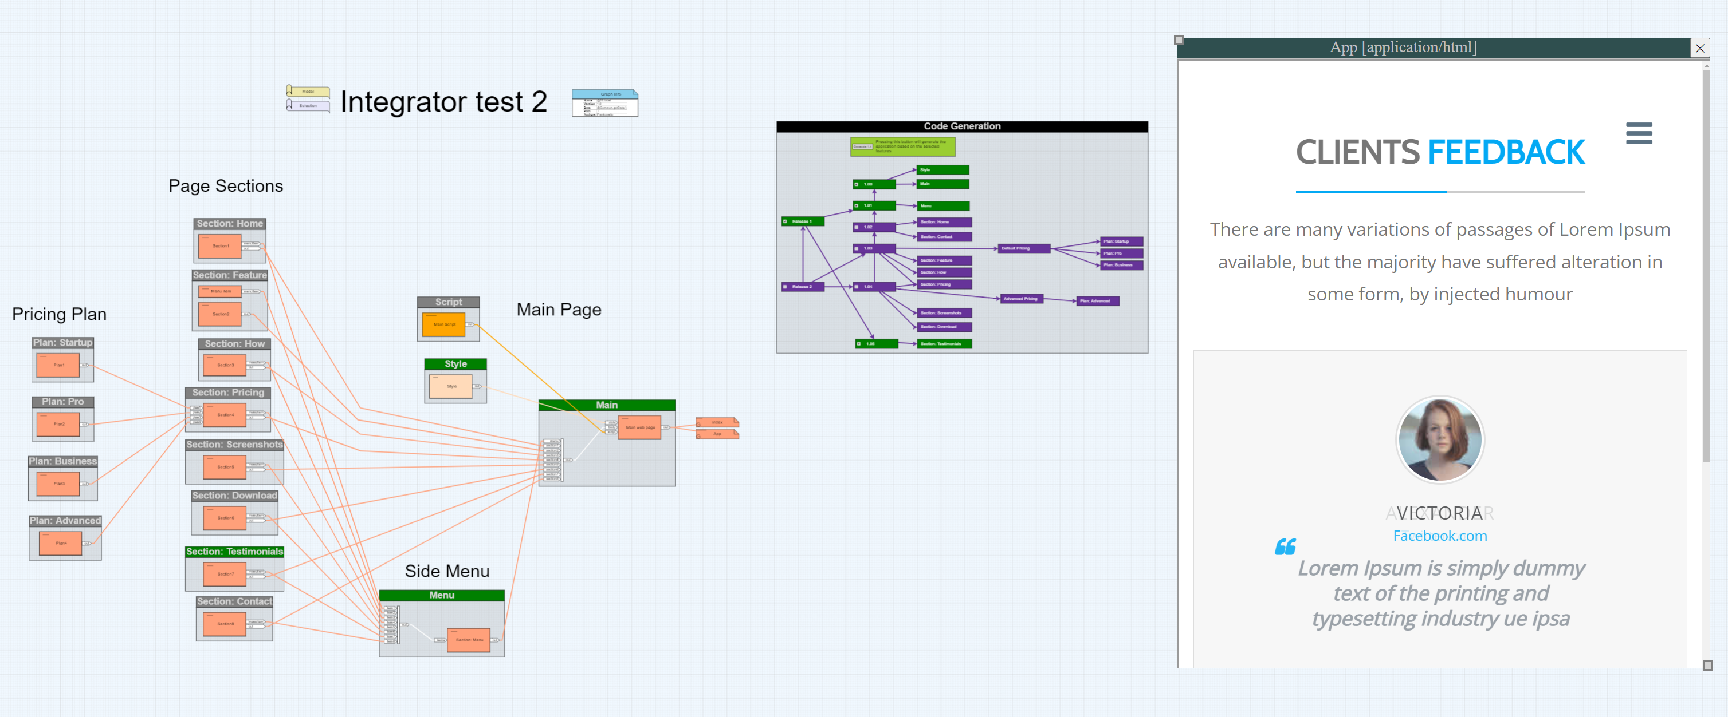

Slide 4
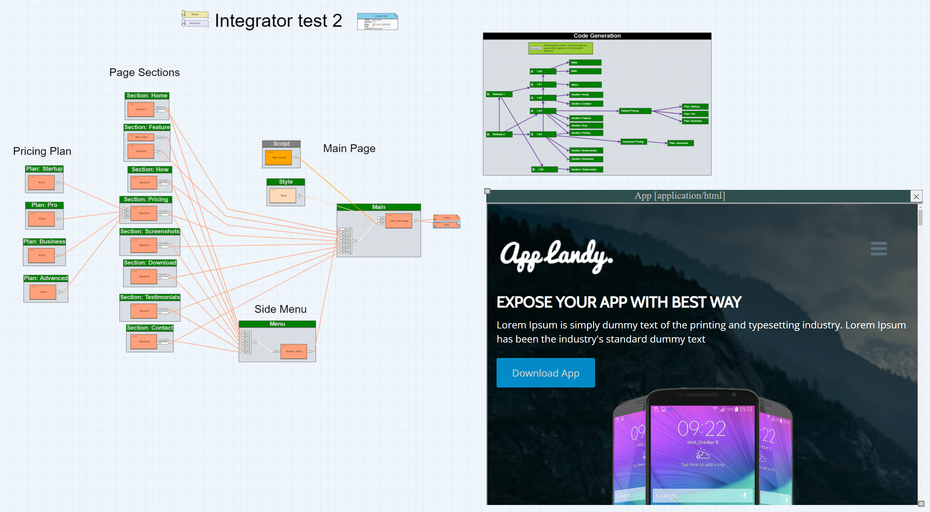

Slide 5
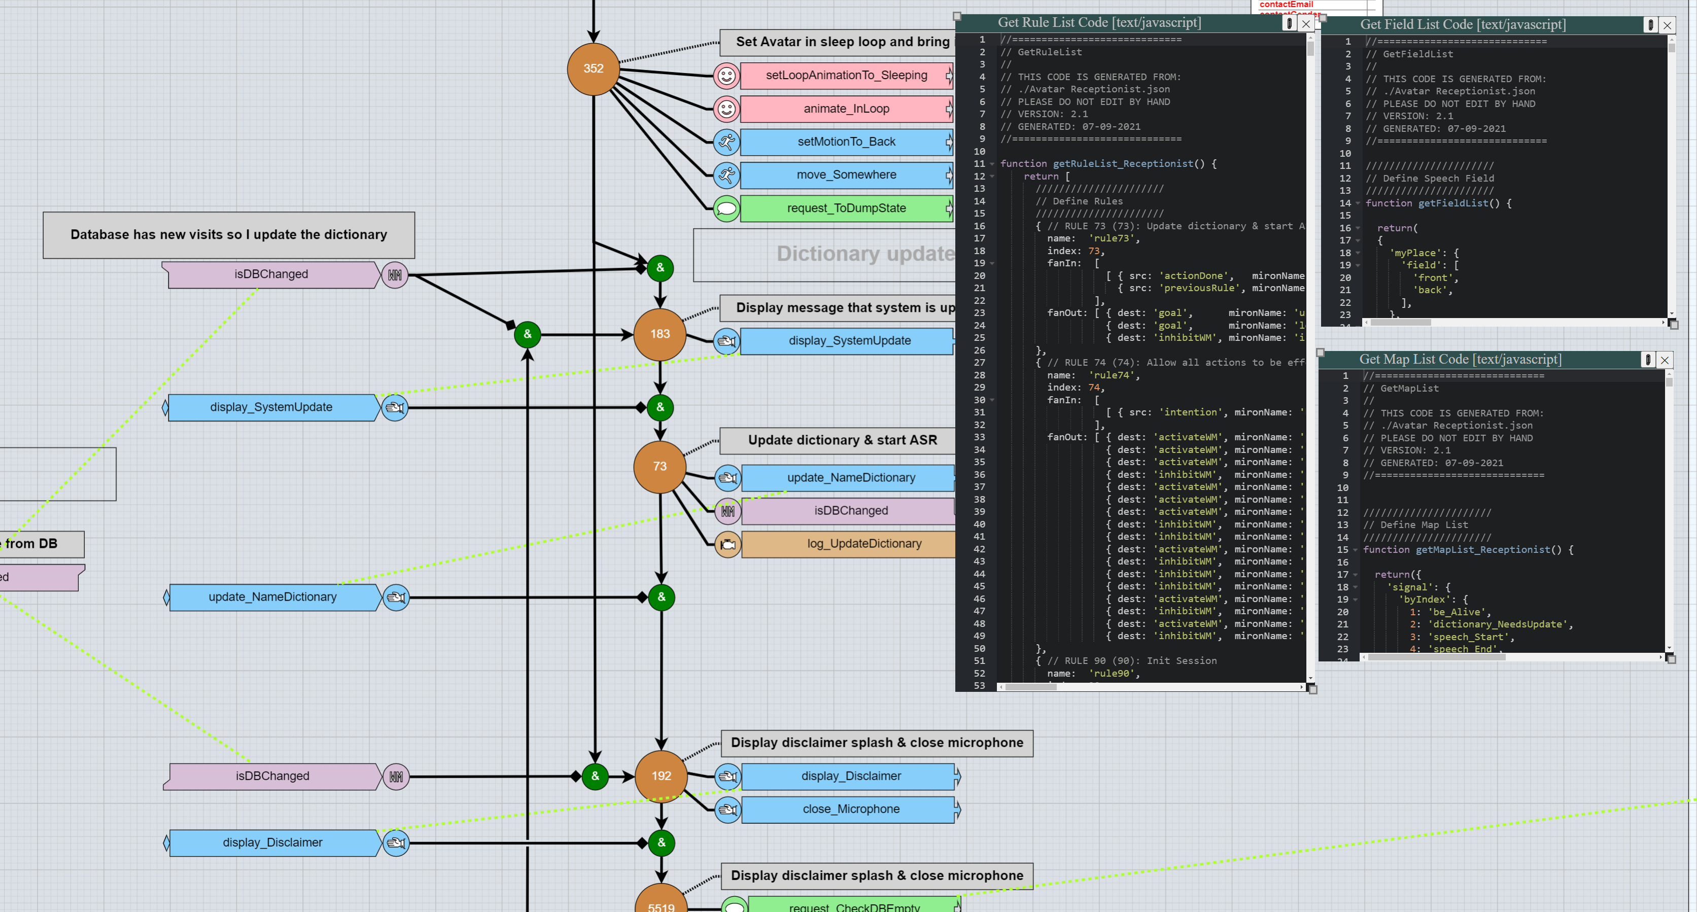

Slide 6
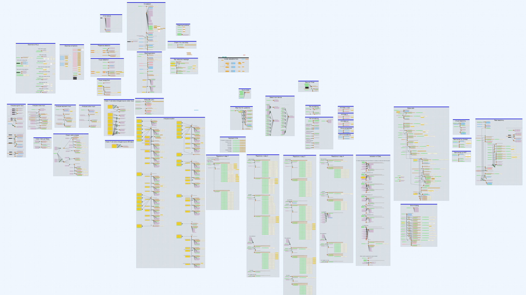



Slide 7
